Slide 1
NUCLEAR AND QUANTUM PHYSICS

Slide 2
E Nuclear and Quantum Physics
E.1 Structure of The Atom
E.2 Quantum Physics
E.3 Radioactive Decay
E.4 Fission
E.5 Fusion and Stars

Slide 3
Quantum mechanics
How will the pattern on the screen look like for double split experiment when we shoot electrons one by one at the double slit? https://www.doubleslitexperiment.app/demo/
What are electrons really? Are they particles?
https://www.youtube.com/watch?v=p9pPjASnnxw
https://www.youtube.com/watch?v=1b8eSJHMv1w

Slide 4
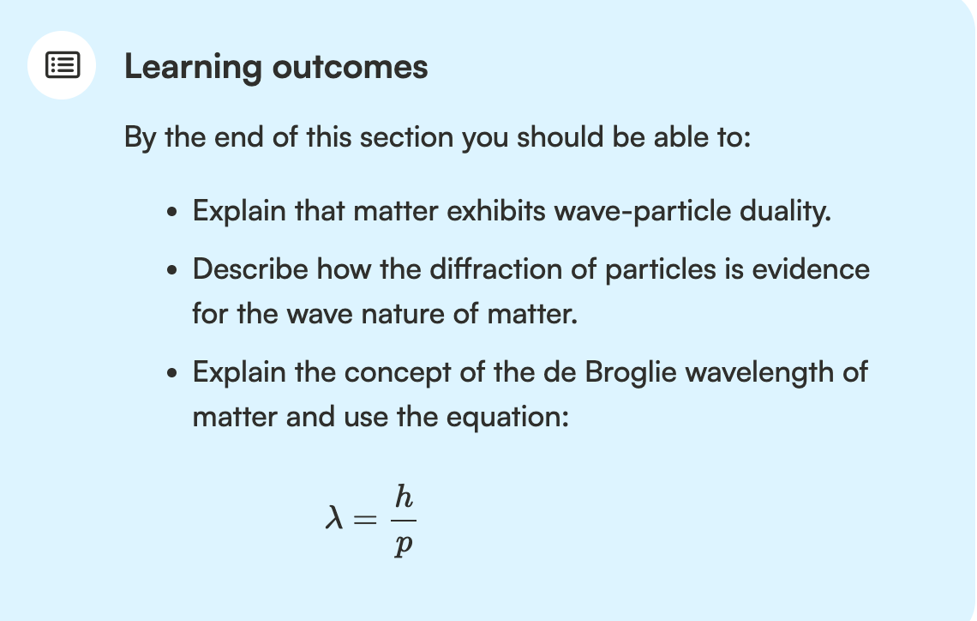
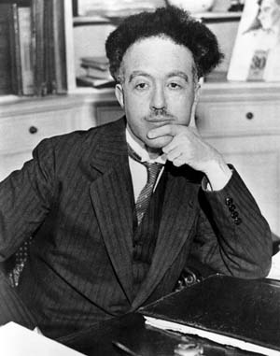
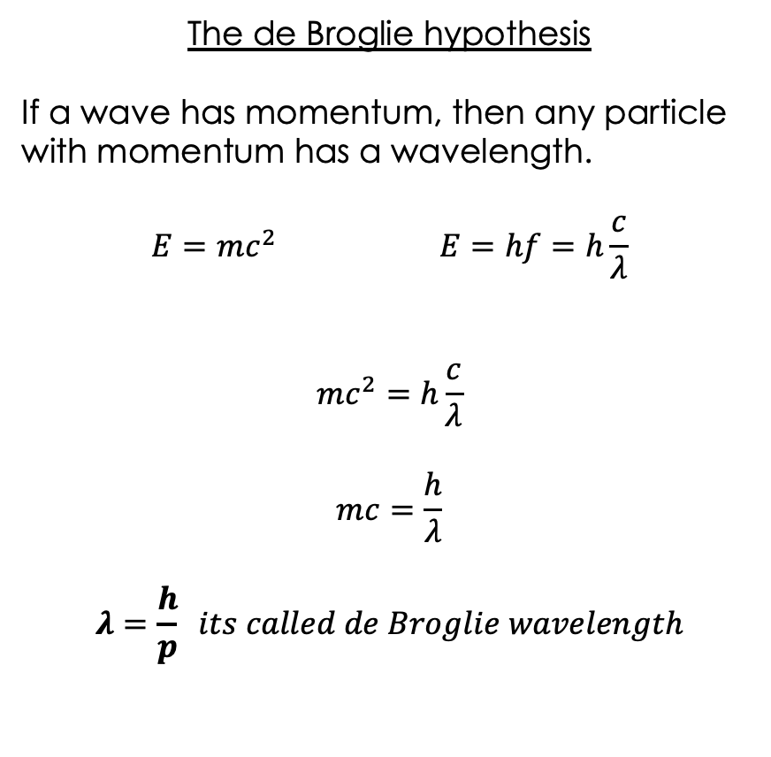
Matter Waves - Duality of Matter

Slide 5
Matter Waves - Duality of Matter
https://www.youtube.com/watch?v=yJXVIlO8Tho

Slide 6

Matter Waves
Calculate the de Broglie wavelength of 60 g tennis ball moving with a velocity of 10 m/s.

Slide 7
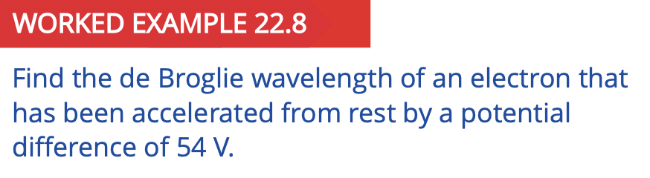
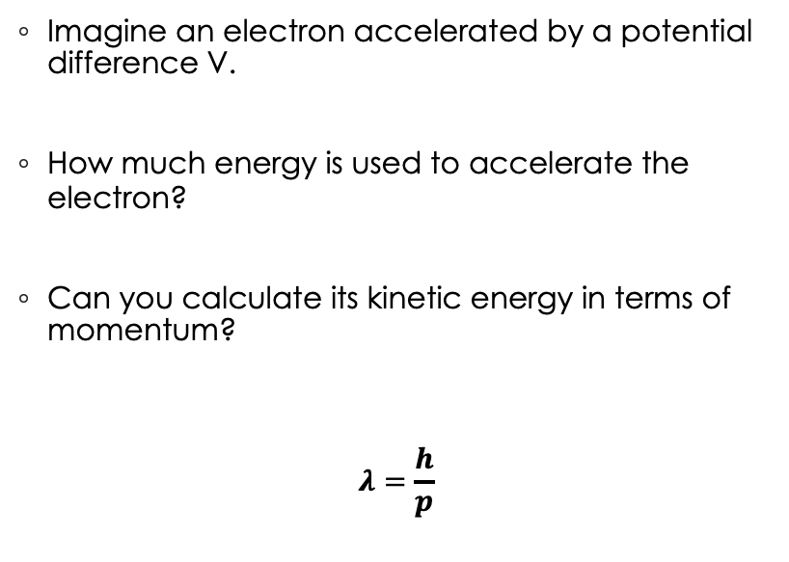
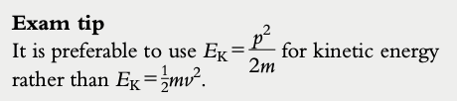
Can we calculate the Broglie wavelength of an electron?
Calculate the de Broglie wavelength of 60 g tennis ball moving with a velocity of 10 m/s.

Slide 8
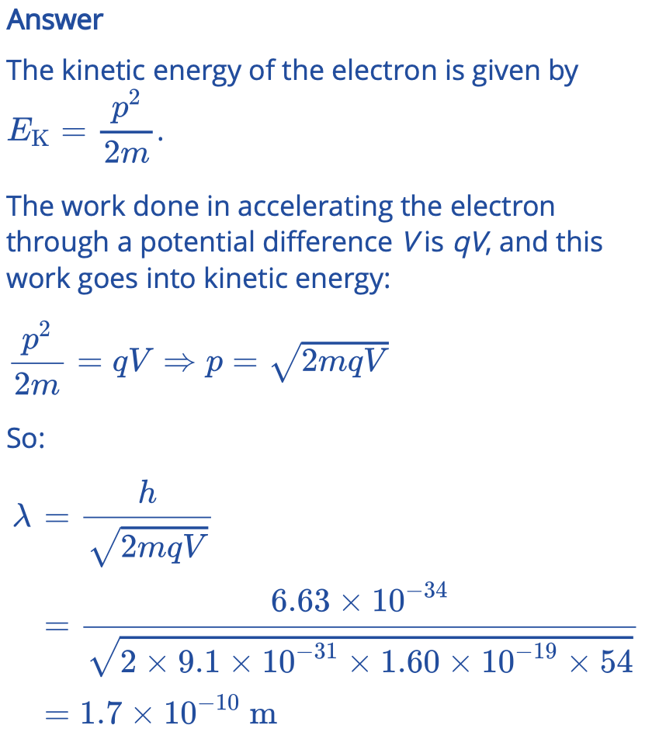

Slide 9
Matter Waves
Imagine you are a scientist in early 20th century. De Broglie just introduced the idea that particles such as electrons could be described not only as particles but also as waves. (1924)
What kind of experiment design could you create to prove his hypothesis, to provide experimental evidence?

Slide 10
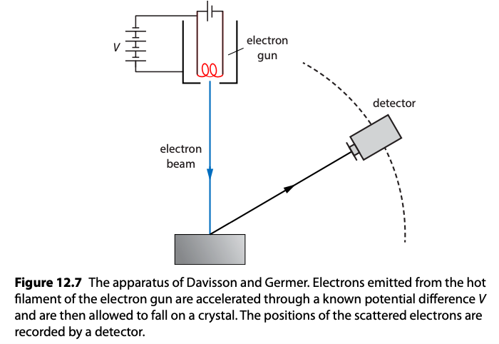
Davisson - Germer Experiment

Slide 11
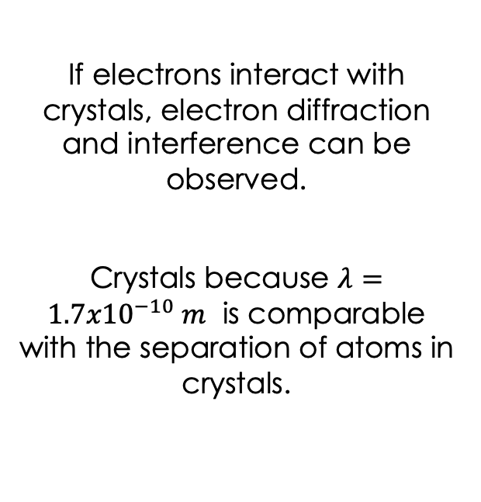
Davisson - Germer Experiment

Slide 12
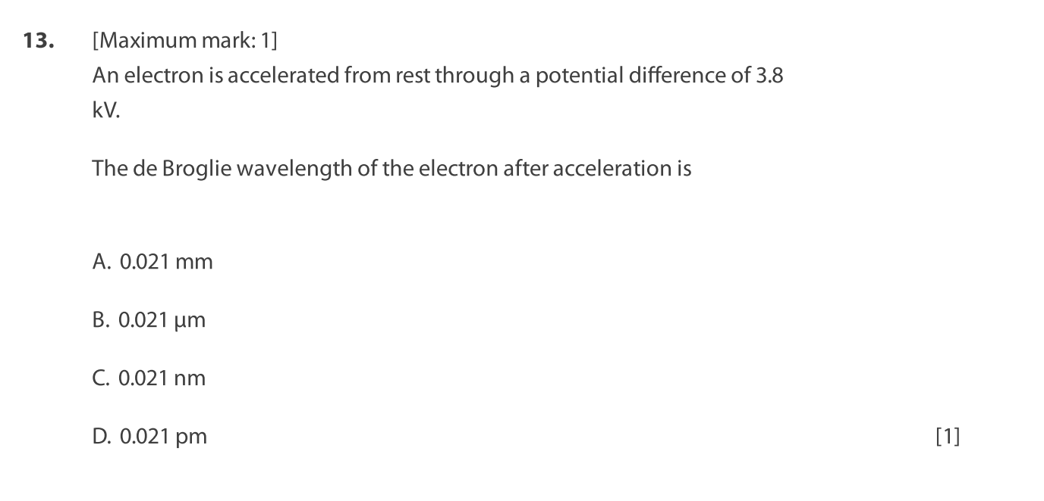
14. Electrons are accelerated through a potential difference and are incident on a sample of crystal atoms causing a diffraction pattern.
When the potential difference is increased, the maxima are …
Paper questions E.2: 11, 12, 14, 16
Keep in mind that Etotal = hf

Slide 13
14. Electrons are accelerated through a potential difference and are incident on a sample of crystal atoms causing a diffraction pattern.
When the potential difference is increased, the maxima are closer together
C
Paper questions E.2: 11, 12, 14, 16
Keep in mind that Etotal = hf

Slide 14
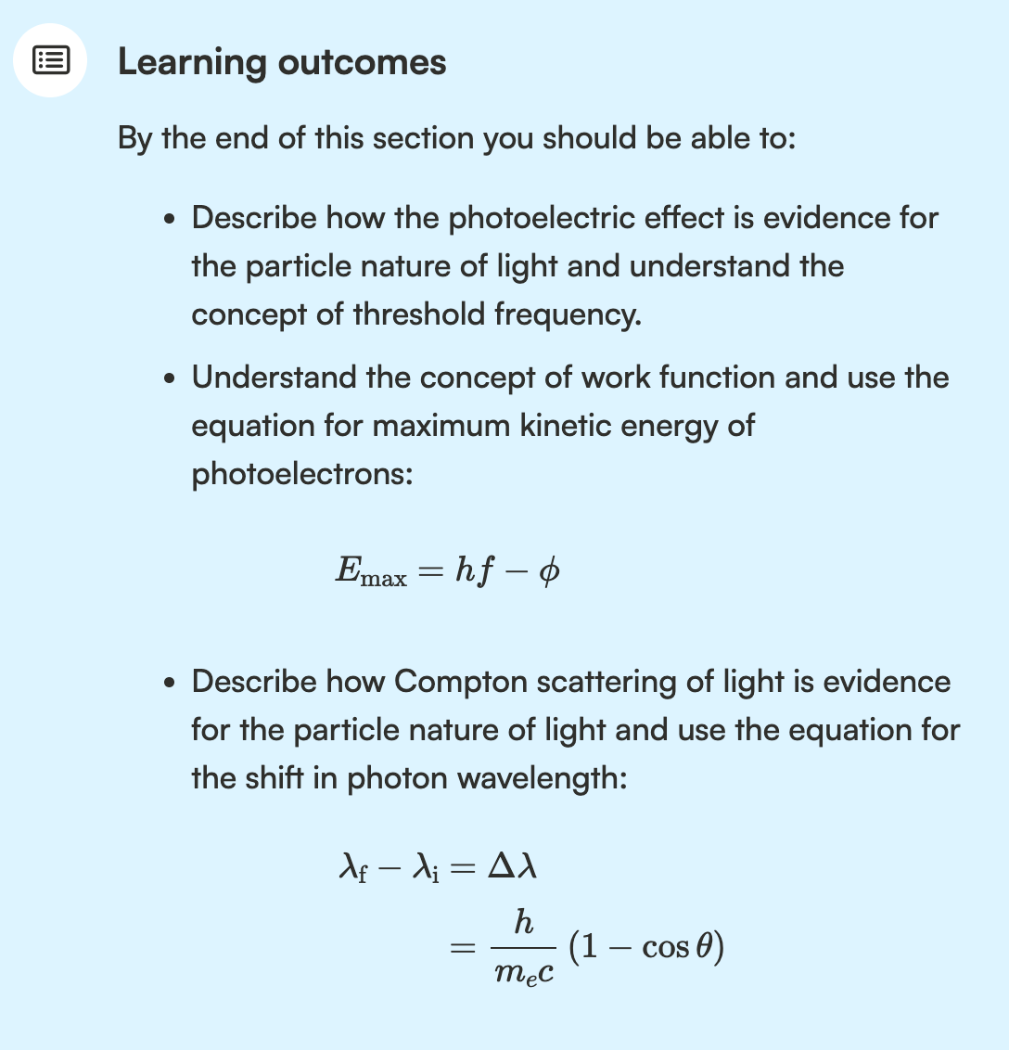
“God does not play dice”

Slide 15
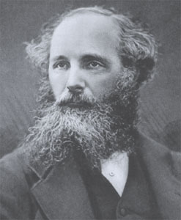
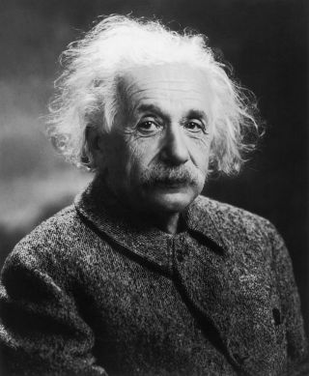
The interaction of matter with radiation
“God does not play dice”

Slide 16
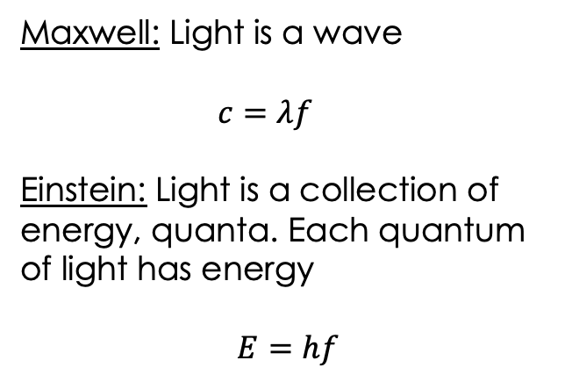
The interaction of matter with radiation
Photoelectric effect
Compton scattering

Slide 17
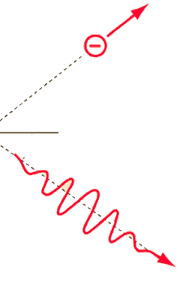
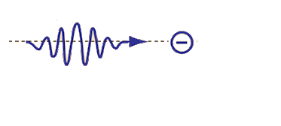


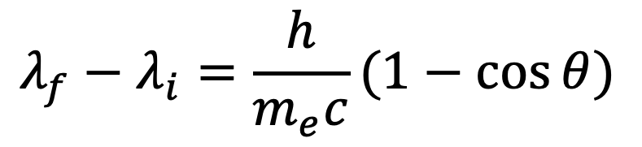
Compton Scattering (klik!)
Recoil
electron
Incident
photon
Target electron
at rest
https://www.youtube.com/watch?v=psIF23CM31M
Compton wavelength

Slide 18
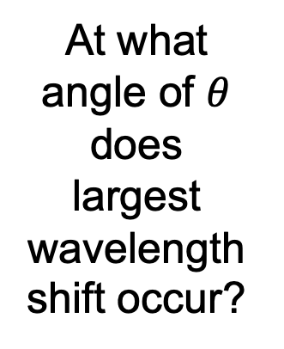
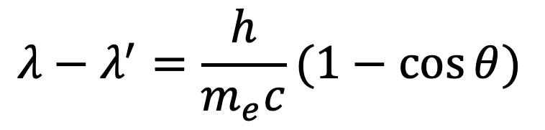
Compton Scattering
Recoil
electron
Incident
photon
Target electron
at rest
Compton wavelength

Slide 19
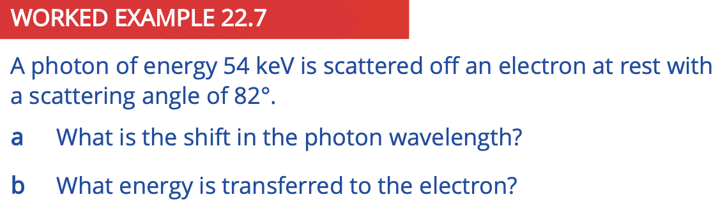
Paper questions E.2: 10, 15, 17

Slide 20
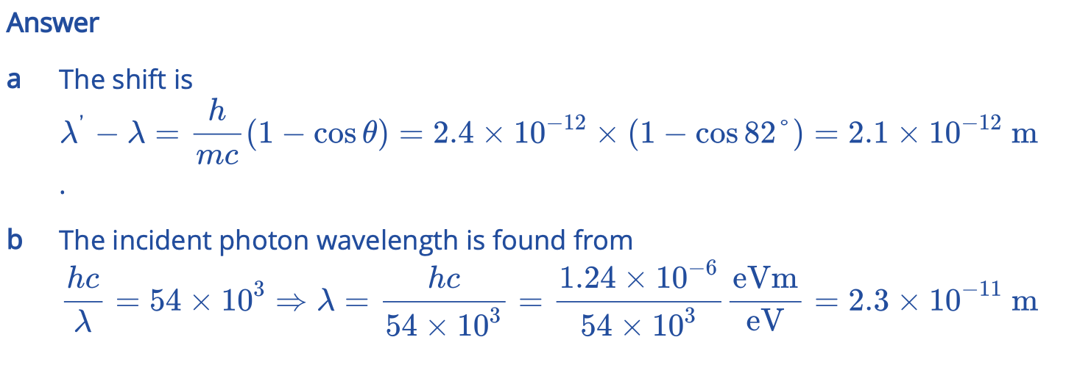
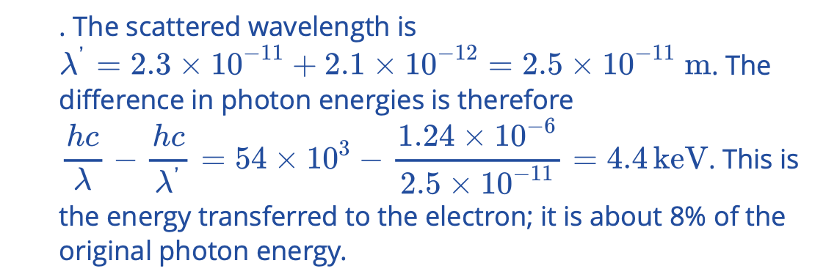

Slide 21
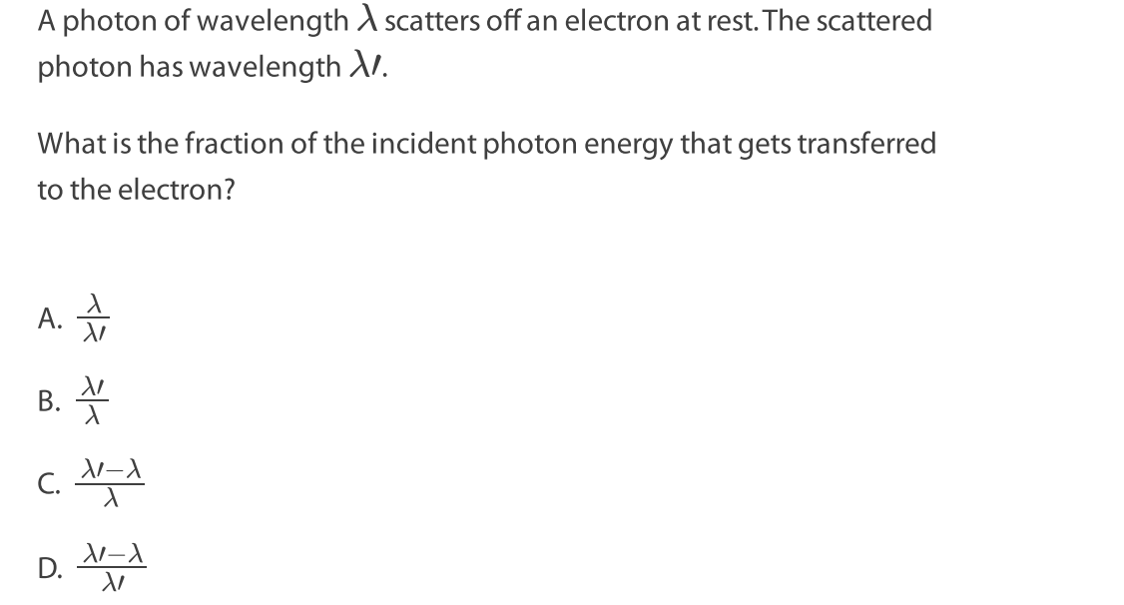
Compton Scattering
Recoil
electron
Incident
photon
Target electron
at rest
Paper questions E.2: 10, 15, 17
Compton wavelength

Slide 22
“God does not play dice”

Slide 23
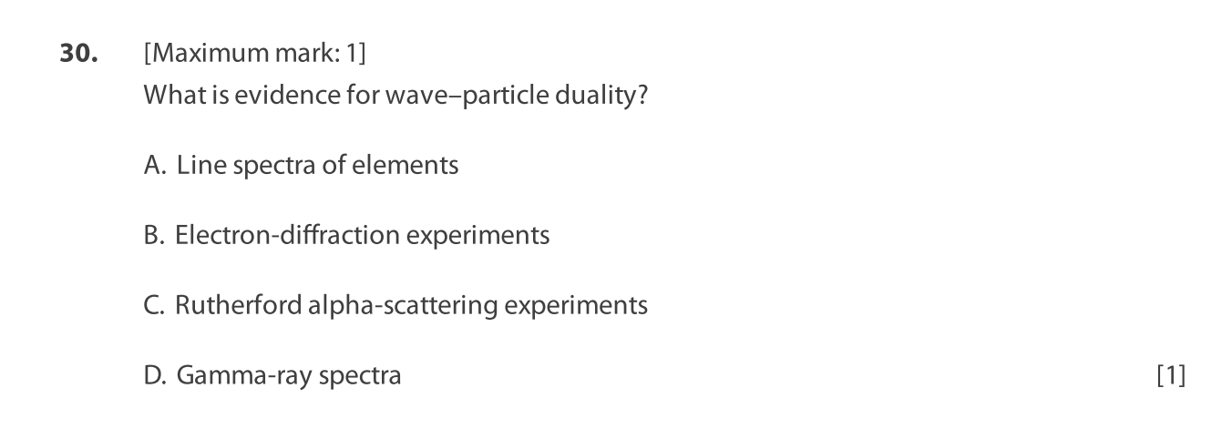
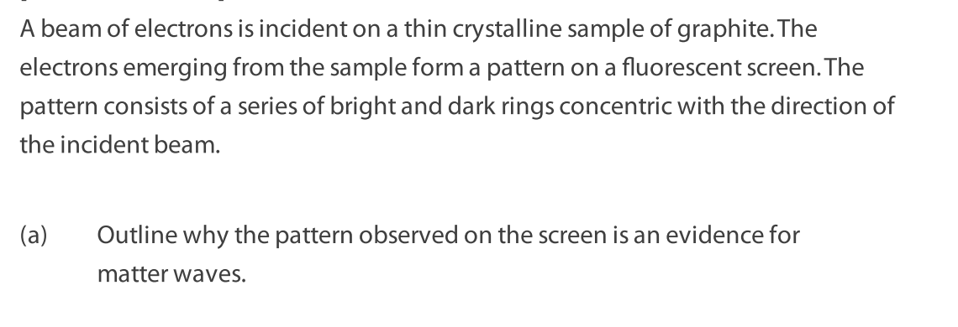
What is particle behaviour?
What is wave behaviour?

Slide 24
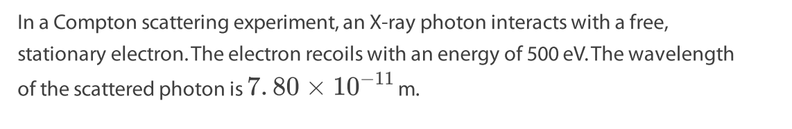
Why does compton scattering show particle behaviour?
How would a wave interact?
Recoil
electron
Incident
photon
Target electron
at rest

Slide 26
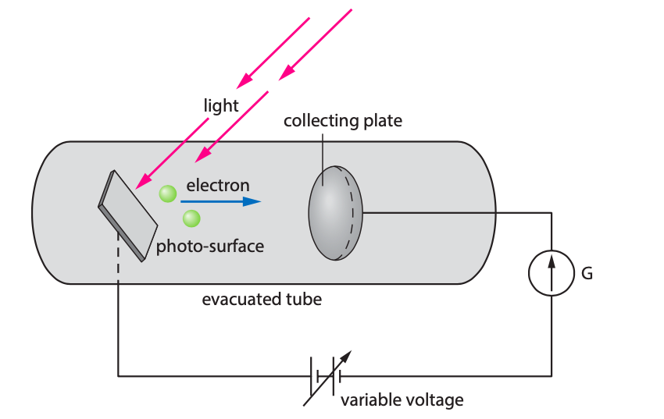
The Photoelectric Effect (klik!)
Why is this an example of the particle nature of light?
What would happen if the voltage is increased?
What would happen if the voltage is made more negative?

Slide 27
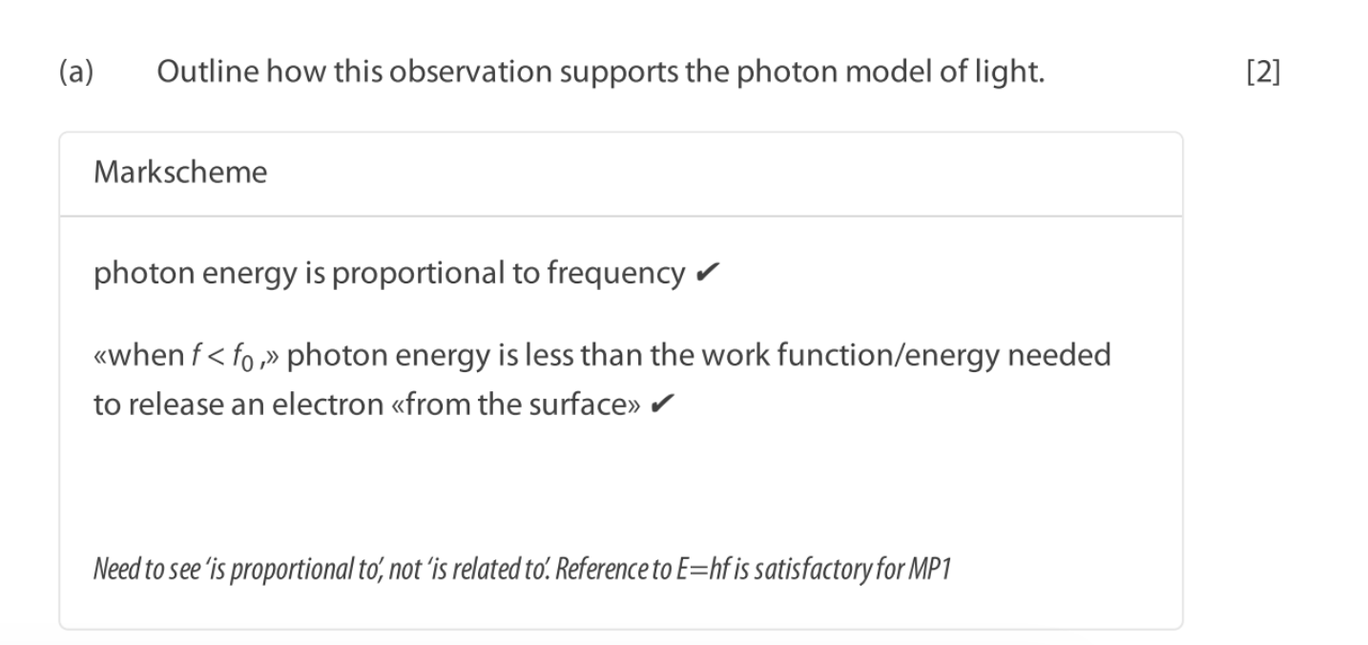
The Photoelectric Effect (klik!)

Slide 28

The Photoelectric Effect
Maximum kinetic energy of a photoelectron

Slide 29
Stopping Voltage
Quantity | Symbol | Definition | Formula | Unit
Stopping Voltage

Slide 30
Stopping Voltage
Quantity | Symbol | Definition | Formula | Unit
Stopping Voltage |  | The voltage at which current becomes zero in photoelectric effect. |  | Volts

Slide 31
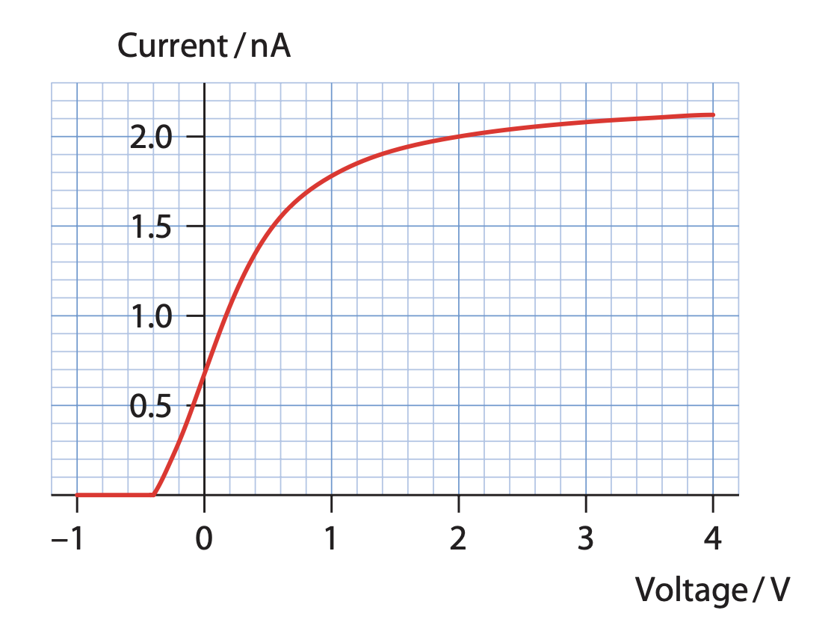
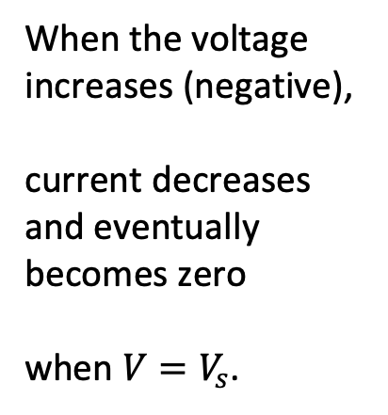
Current vs Voltage

Slide 32
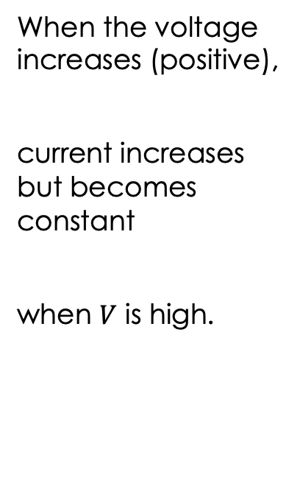
Current vs Voltage

Slide 33
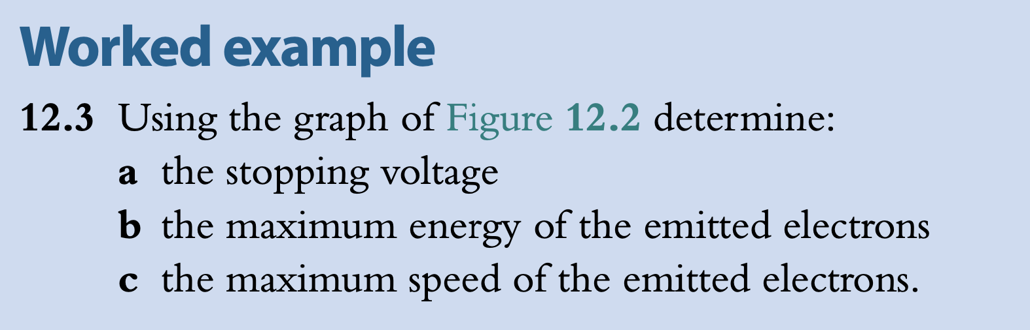

Slide 34
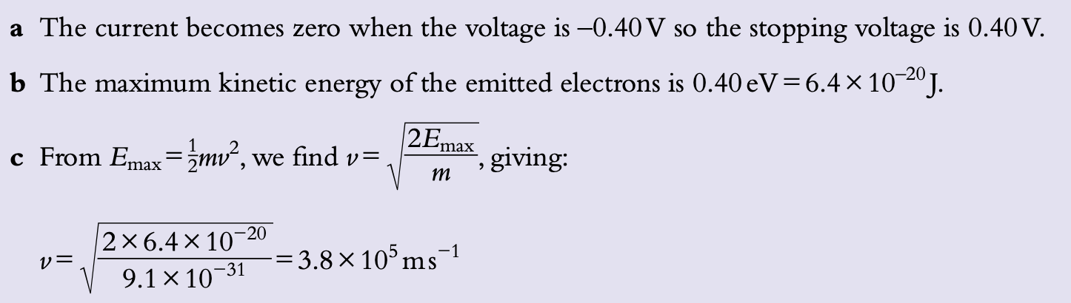

Slide 35
Simulation
How does the intensity of incident light affect current? Why do you think this happens?
Pick a negative voltage value in the simulation so that current is zero, check if increasing the intensity affect current.
Does intensity increase the speed of the electrons, their kinetic energy?

Slide 36
Simulation
How does the intensity of incident light affect current? Why do you think this happens? As intensity increases, current increases. More intensity means more photon particles.
Pick a negative voltage value in the simulation so that current is zero, check if increasing the intensity affect current. Current does not change because energy of the electrons depends on the stopping voltage.
Does intensity increase the speed of the electrons, their kinetic energy? No

Slide 37
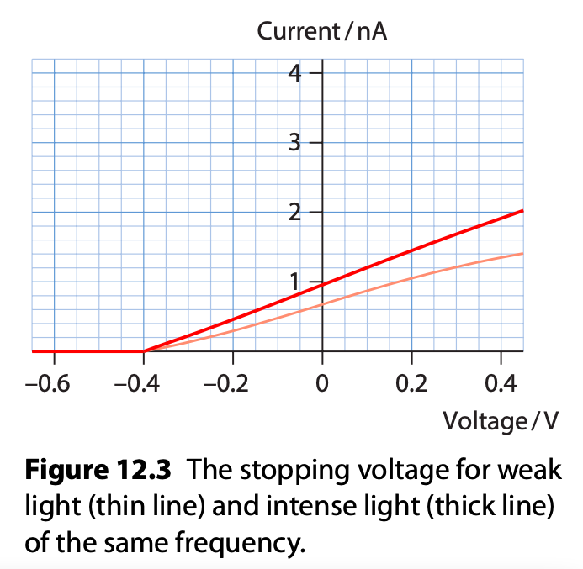
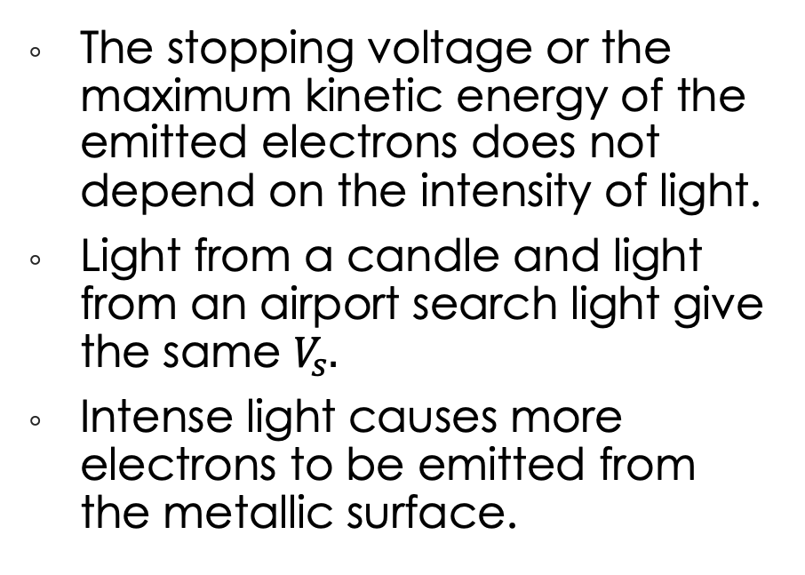
Effect of Intensity of Light

Slide 38
Simulation
How does the frequency/wavelength of light affect current?
How does it affect the kinetic energy of the electrons?
Does photoelectric effect happen regardless of the frequency/wavelength of light?
Finally:
Draw the change in the current over voltage graph after making the intensity of the light lower
Draw the change in the current over voltage graph after making the frequency of the light smaller.

Slide 39
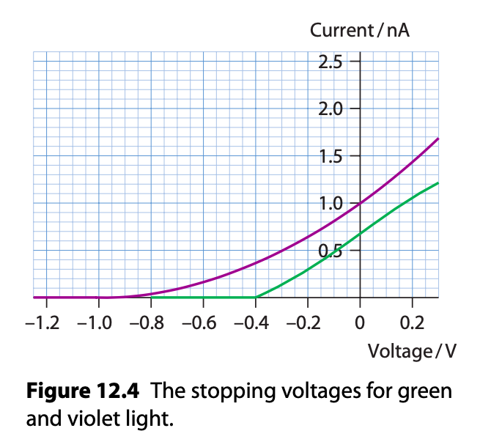
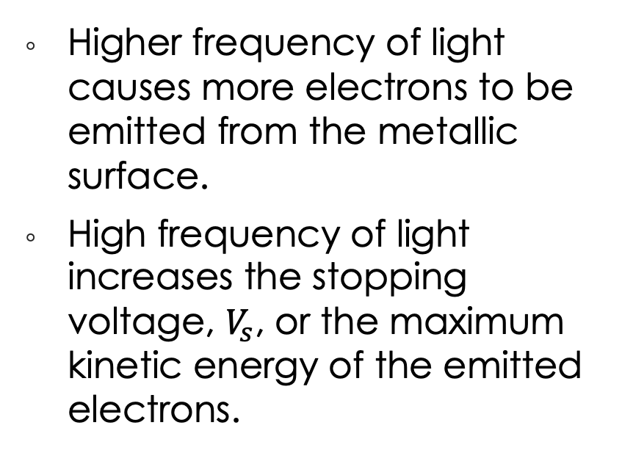
Effect of Frequency of Light

Slide 40
Important Graphs

Slide 41

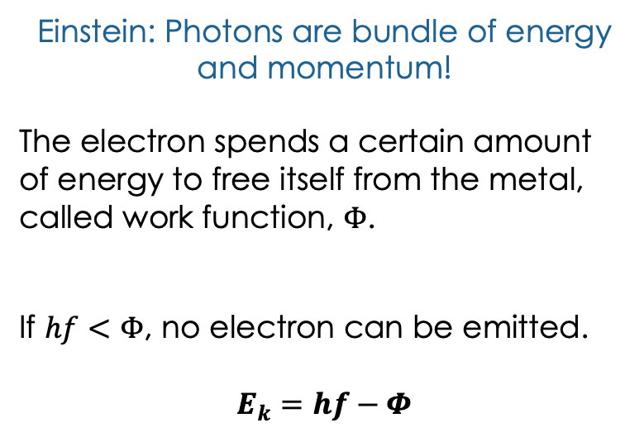
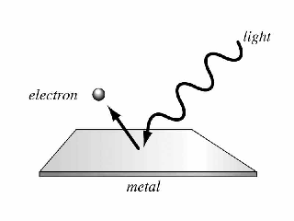

Slide 42
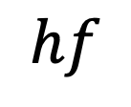




Energy of the photon
Energy lost
Energy of electron

Slide 43
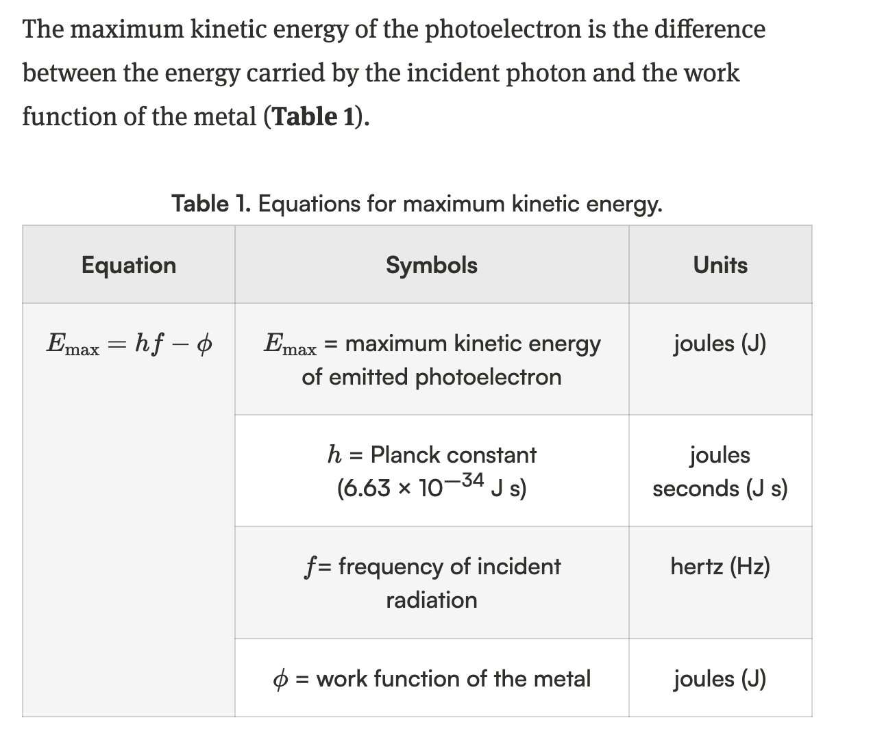
Photoelectric Effect

Slide 44
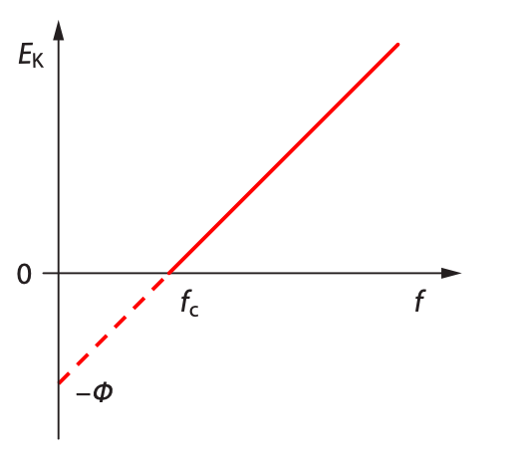
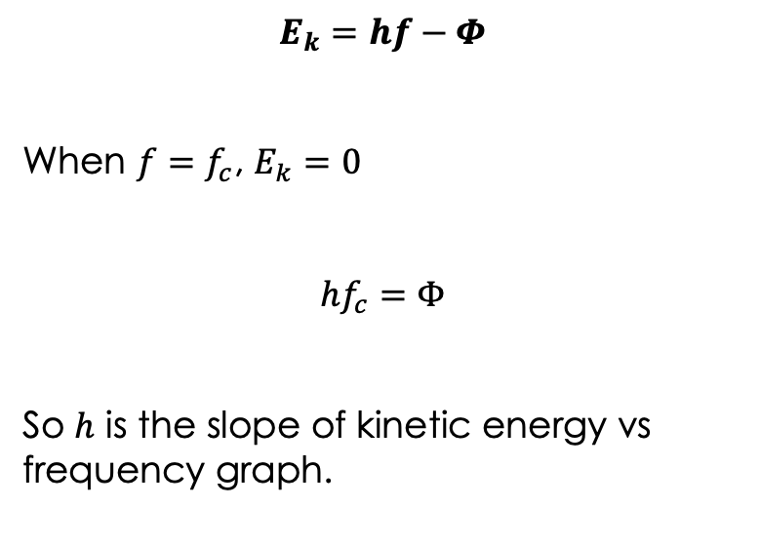
The Photoelectric Effect

Slide 45
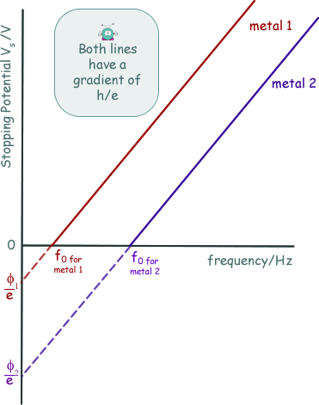
The Photoelectric Effect
Work function is a property which is constant for each metal surface.

Slide 46
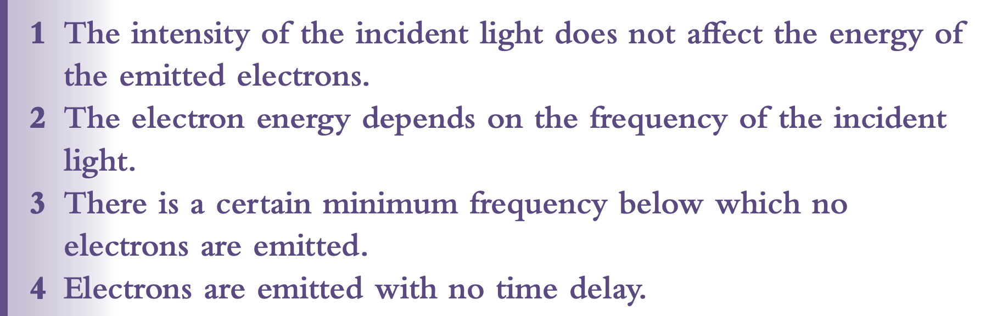
Photoelectric Effect

Slide 47
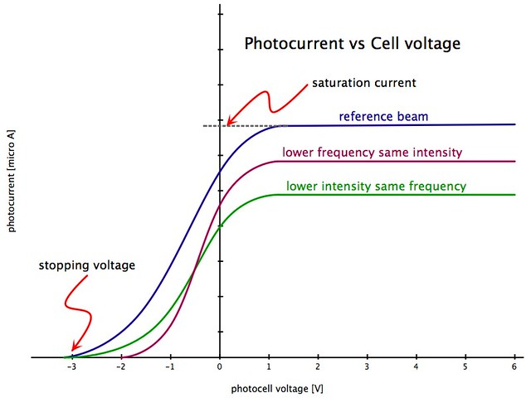
The Photoelectric Effect

Slide 48
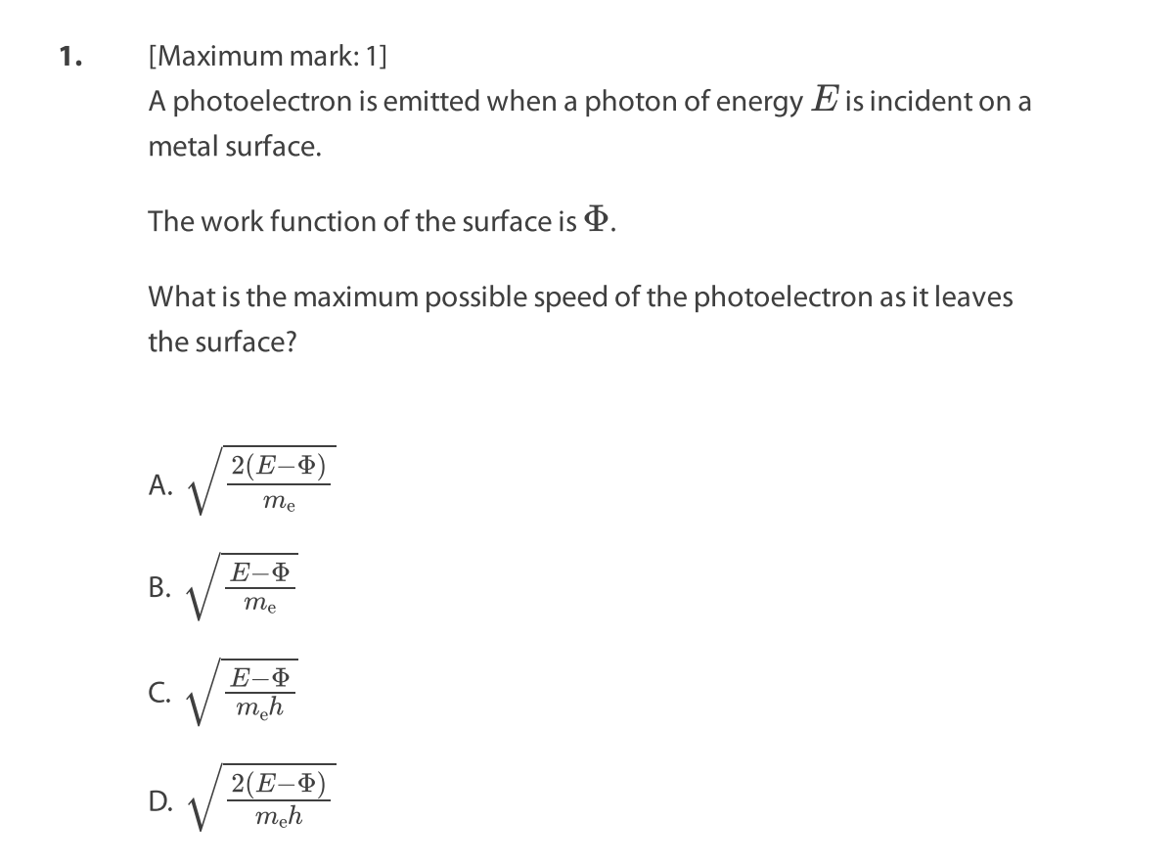
d. What happens to the curve if I increase the intensity of light incident on the metal?
e. What happens to the curve if I increase the wavelength of light incident on the metal?

Slide 49
Photoelectric Effect
Paper questions E.2:
1, 3, 4, 7, 23

